Slide 1
TS-Benchmark: a benchmark for time series databases
Yueguo CHEN
DBIIR Lab, Information School
Renmin University of China
Dec., 2018

Slide 2
TS-Benchmark: a benchmark for time series databases
Agenda
Background
Ideas of a new benchmark
Application scenarios
Data model and data generation
Workload model and performance metrics
Testing results of some representative time series database systems
Q&A

Slide 3
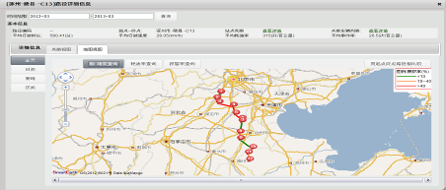
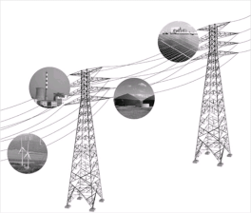
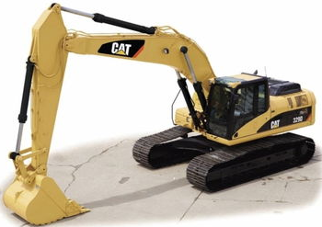
TS-Benchmark: a benchmark for time series databases
Background
Big volume of time series is generated from IOT applications of various business domains, including
Manufacturing
Agriculture
Military
Smart city
Logistics
Sensors in scientific instruments
Energy (turbine)
…
Applications
Monitoring, querying, and root cause analysis…
High Speed
Million data points/sec
24hours*7
Data
big volume of time series

Slide 4
TS-Benchmark: a benchmark for time series databases
Ideas of a new benchmark
Existing benchmarks
TPC-C
test RDBMSs’ transaction processing capability
YCSB
Test data serving capability of NoSQL databases
InfluxDB-comparisons
Model after server farm monitoring scenarios
Data is small, workload is simple
Stream Bench, RIoTBench, Linear Road
Designed many years ago, not considering data processing requirements of time series of big data applications
Some benchmarks test stream systems, which process data in a streaming manner
Design and implement a new benchmark
Designed Specifically for time series databases in IOT application scenarios
Model the sensor data processing scenario of wind farms
Testing of data appending, querying and combination of the two, i.e. when data is continuously injected into the target database, users can query the data in the same time
Testing of data correction, including updating of error data, and inserting of missing data
Long enough testing time to see how target databases’ house keeping (data compaction etc.) affects its data appending and query performance

Slide 5
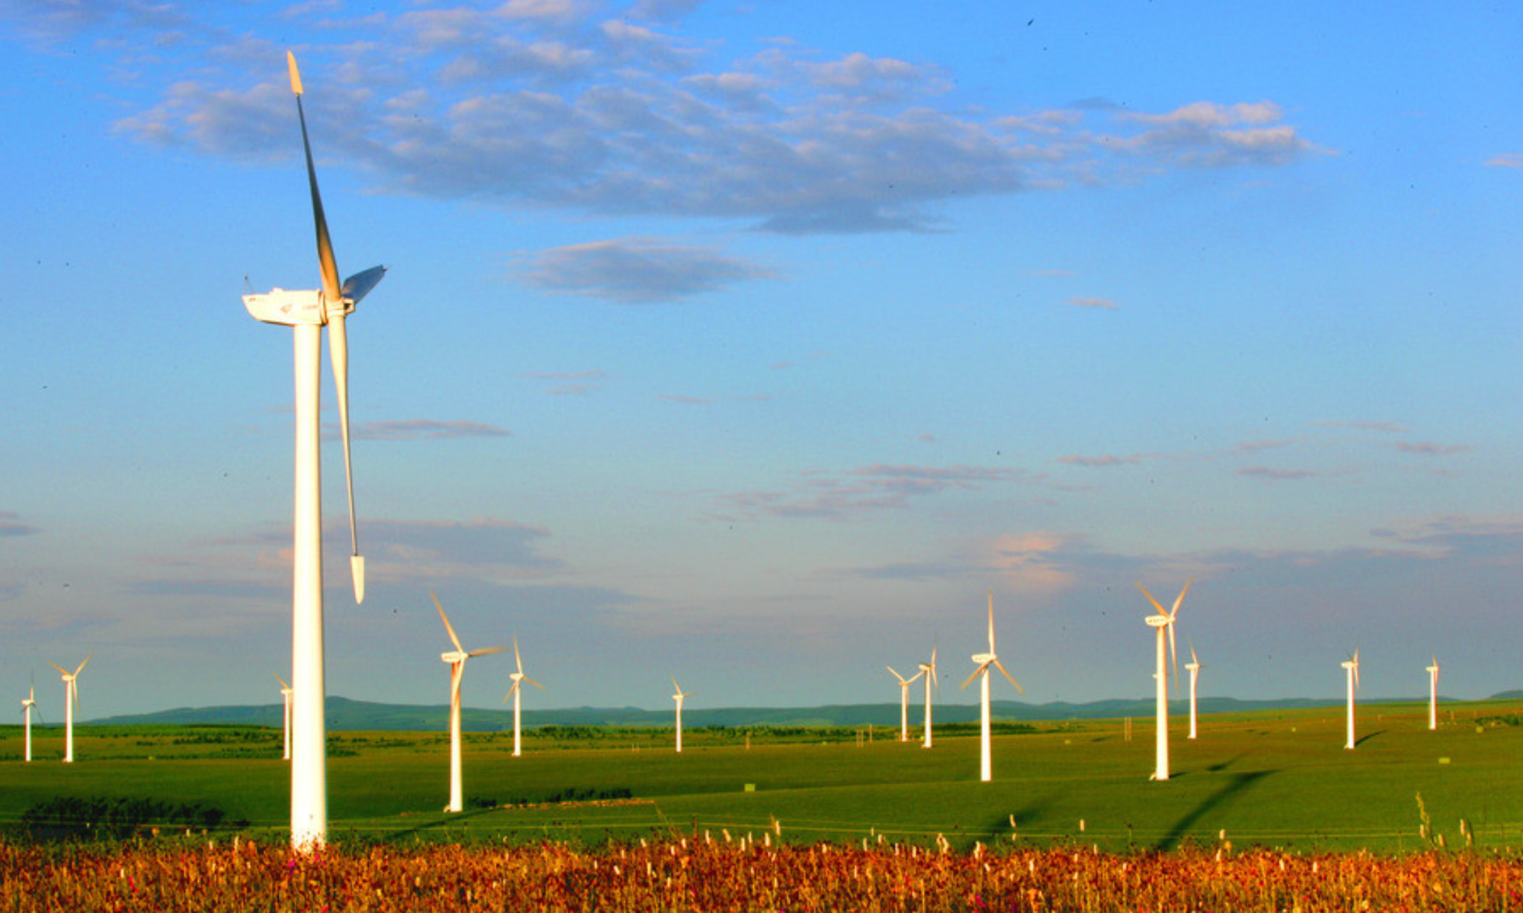
TS-Benchmark: a benchmark for time series databases
Application scenarios
A wind plant needs to monitor wind farms
There are hundreds of turbines(devices) in a wind farm
And there are many sensors attached to a device
Every several seconds(7s), a snapshot of sensor data is sent to back end(cloud) for monitoring and persistency

Slide 6
TS-Benchmark: a benchmark for time series databases
The Data model and data generation
Schema：Each data point has attributes as follows
Wind farm id, device id, sensor id, time stamp and the reading of the sensor
There are two types of sensors
Sensors sensing the environment：temperature, humidity, wind speed, wind direction etc.
Sensors sensing the turbines : pitch angle俯仰角, upwind angle迎风角, angular velocity角速度, electric voltage电压, electric current电流, installed power安装功率, nominal power额定功率, temperature inside, humidity inside, vibration frequency etc.
Firstly, we train an ARIMA time series model with one year long wind power data provided by GoldWind company.
Secondly, we use the trained ARIMA model to continuously generate wind data for each turbine. Based on wind data, and the mechanism to transform wind data to wind power we generate core sensor data for each turbine.
Beside that, we also use ARIMA models to learn and generate other sensor readings, such as temperature and humidity etc.

Slide 7
TS-Benchmark: a benchmark for time series databases
Workload model and performance metrics
Load：generate a dataset of a windfarm for 7 days, and test loading performance (points/sec)
Append：increase number of devices (through number of client threads), test appending performance(points/sec)
Query(simple Read and Analysis)：run a query workload which includes simple window range query and aggregation query, against the target database (requests/sec, average response time(us))
Simple query is for monitoring purpose
Aggregation query is for root cause analysis
The mix ratio is 90:10, think time between query is 50ms
Stress Test：includes two modes
Mode 1: Stress test of data injecting capability when there is a query workload (points/sec)
Mode 2: Stress test of query handling capability when there is a data injecting stream (requests/sec, average response time(us))
In future version of benchmark, we will add two tests, including updating of error data, and inserting of missing data

Slide 8
TS-Benchmark: a benchmark for time series databases
Testing procedure
The whole testing include 5 stages as follows
Data generation
Loading testing
Append Testing
Querying testing
Stress Testing

Slide 9
TS-Benchmark: a benchmark for time series databases
Target database systems to be tested
InfluxDB
InfluxDB is a scalable time series database for recording metrics, events, and performing analytics. It use the TSM (Time-Structured Merge Tree) data structure for data storage and enjoy a very high data appending speed.
IotDB
Developed by Tsinghua University of China. Built upon TsFile, which is a columnar file format supporting highly data compression, fast data fetch, and data updating.
TimescaleDB
A time series database built upon PostgreSQL, which is a mature relational database system. TimescaleDB has a complete SQL support.
Druid
an open-source column-oriented data store, designed for online analytical processing (OLAP) queries on event data.
OpenTSDB
A time series database built upon HBase, which is a scalable distributed NoSQL database running on Hadoop

Slide 10
TS-Benchmark: a benchmark for time series databases
Testing hardware and software environment
We are benchmarking single server version of InfluxDB, IotDB, TimescaleDB, Druid, and OpenTSDB
Hardware
a server with Intel(R) Xeon(R) CPU E5-2620 @ 2.00GHz(12cores, 2 thread each core, 24threads in total), 32GB of memory, 2TB of 7200rpm SATA Hard disk
Database server is bound to 4 cores(8 threads)
The client program runs on the same server to avoid network latency
Software
CentOS 7.4.1708
JDK 1.8

Slide 11
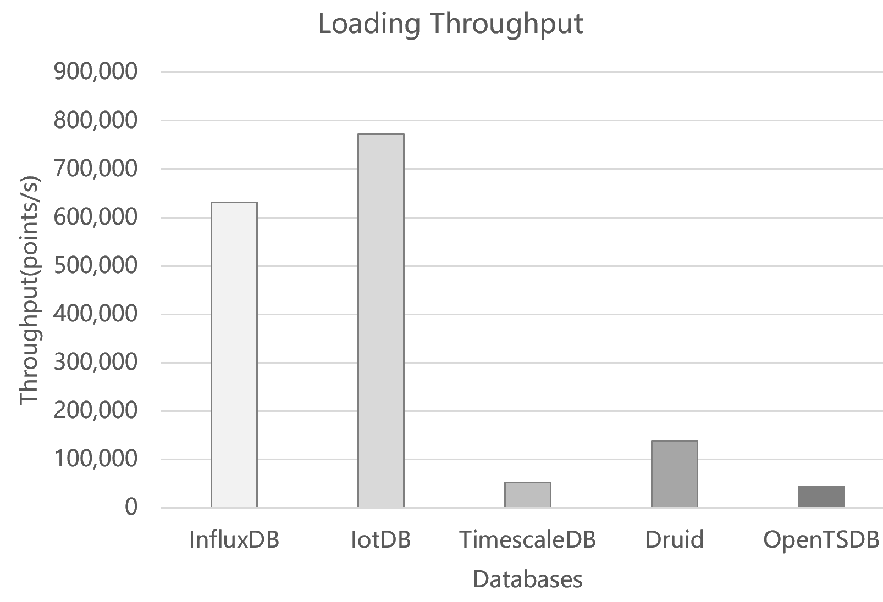
TS-Benchmark: a benchmark for time series databases
Loading Test
We generate data set of wind farm sensor data for 7 days, and store the data in a file.
100 devices, 150 sensors/device, a snapshot of sensor data for every device per 7 seconds.
The data file in loaded into memory first, and loaded into target databases to avoid I/O cost to see how fast the databases handle the data injection.
10 threads are loading the data into databases, the database under test is running on 4 cores(8threads).
IotDB achieves a highest throughput of 772,406 points/s, and InfluxDB achieves a comparable throughput of 631,227 points/s.
TimescaleDB, Druid, and OpenTSDB are much inferior on loading, they achieve throughputs of 52,794p/s, 138,907p/s, and 44,027p/s respectively.
InfluxDB | IotDB | TimescaleDB | Druid | OpenTSDB
631,227 | 772,406 | 52,794 | 138,907 | 44,027

Slide 12
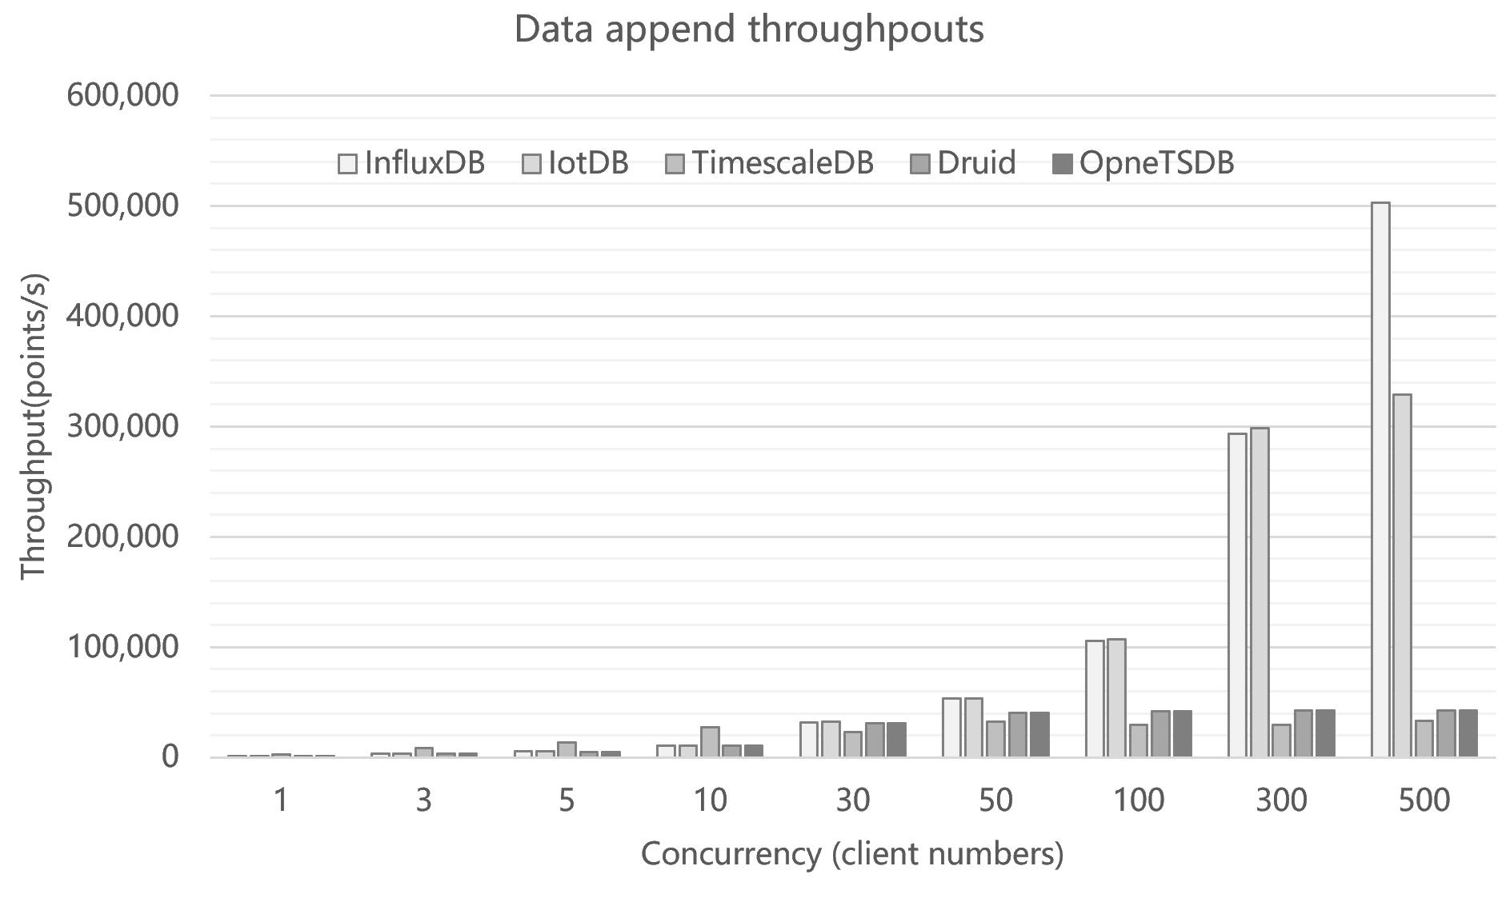
TS-Benchmark: a benchmark for time series databases
 | InfluxDB | IotDB | TimescaleDB | Druid | OpenTSDB
1 | 1,070 | 1,071 | 2751 | 1,070 | 1,070
3 | 3,214 | 3,214 | 8257 | 3,180 | 3,180
5 | 5,357 | 5,357 | 13284 | 5,288 | 5,288
10 | 10,683 | 10,709 | 27647 | 10,510 | 10,510
30 | 32,047 | 32,138 | 23254 | 30,810 | 30,810
50 | 53,146 | 53,466 | 32761 | 40,510 | 40,510
100 | 105,687 | 107,003 | 29250 | 41,710 | 41,710
300 | 293,063 | 298,808 | 29,631 | 42,566 | 42,566
500 | 502,900 | 329,172 | 33,268 | 42,841 | 42,841
Appending Test – throughput
Each client thread is responsible for appending data of 50 devices. Each device has 150 sensors, and every 7 seconds a snapshot of sensor readings is sent.
We gradually increase the number of clients to increase pressures and measure the throughputs and response times of target database.
With the number of clients increasing, IotDB and InfluxDB achieve comparable throughputs when the concurrency is low ( client number <= 300).
When the number of clients further increase(concurrency is high ), InfluxDB achieve much higher throughput than IotDB.
TimescaleDB, Druid, and OpenTSDB are much inferior on appending than IotDB and InfluxDB.

Slide 13
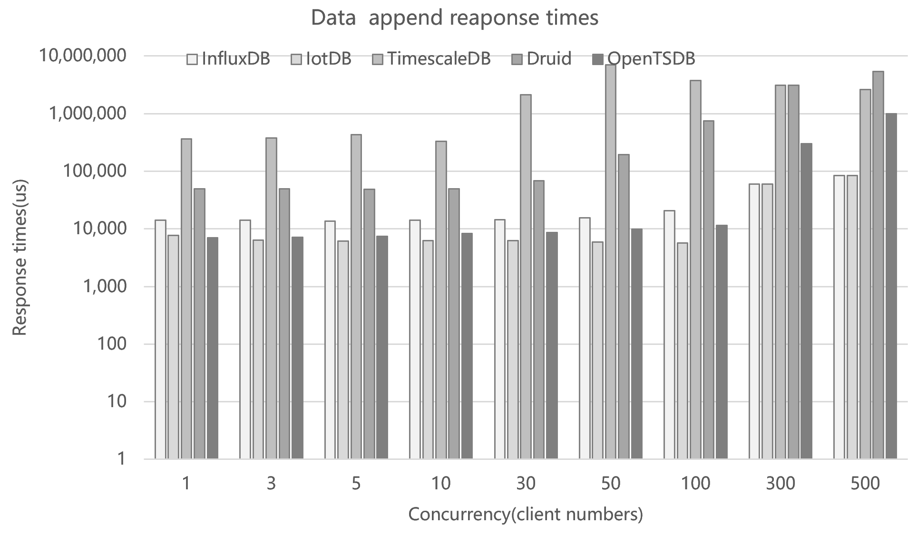
TS-Benchmark: a benchmark for time series databases
 | InfluxDB | IotDB | TimescaleDB | Druid | OpenTSDB
1 | 14,096 | 7,666 | 363347 | 49,935 | 7,000
3 | 14,054 | 6,412 | 380465 | 49,429 | 7,130
5 | 13,720 | 6,129 | 428345 | 48,281 | 7,422
10 | 14,156 | 6,282 | 332666 | 49,568 | 8,369
30 | 14,297 | 6,274 | 2131416 | 68,728 | 8,601
50 | 15,461 | 5,856 | 7015567 | 194,478 | 9,934
100 | 20,575 | 5,666 | 3765096 | 752,511 | 11,412
300 | 59,317 | 59,317 | 3,103,219 | 3,083,258 | 298,656
500 | 84,571 | 84,571 | 2,600,111 | 5,419,355 | 993,259
Appending Test – response times
We have measured max, min, average response times of each data points handled by target databases.
When concurrency is low, OpenTSDB(client number <=300) and IotDB achieve better response times than InfluxDB.
However when concurrency is high(client number >300), InfluxDB achieves better response time than OpenTSDB, and equal response time to IotDB.
Although when the concurrency is low, Druid is better than TimescaleDB in terms response time.
Both Druid and TimescaleDB get the worst response times.

Slide 14
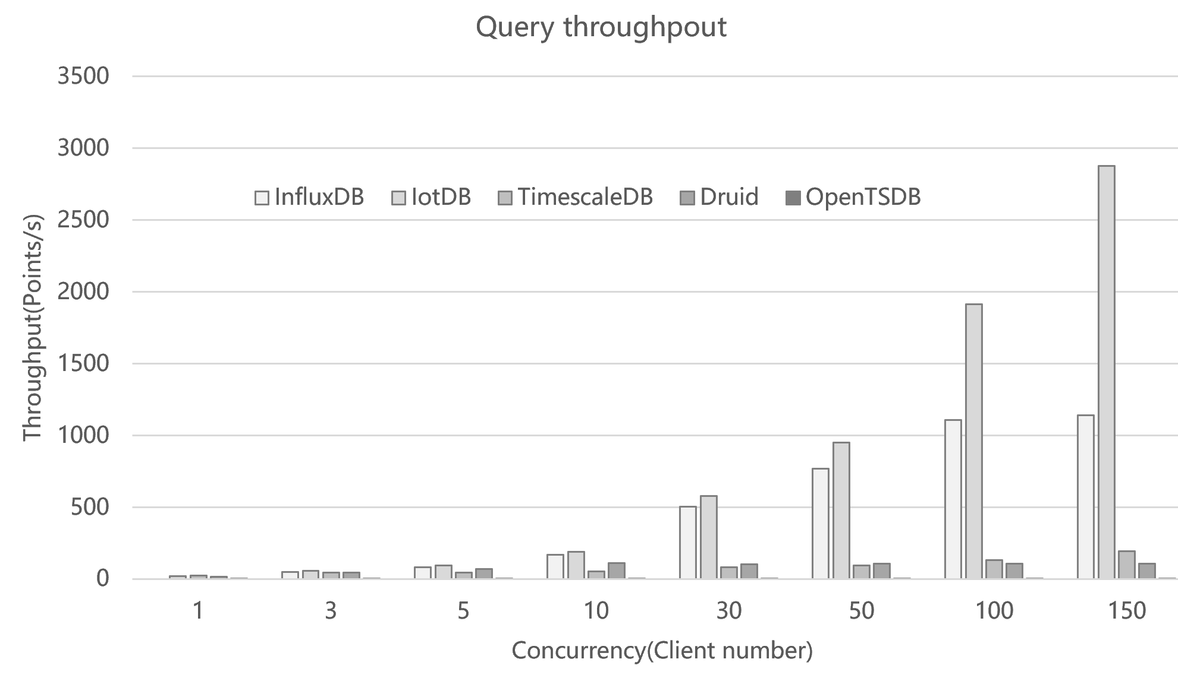
TS-Benchmark: a benchmark for time series databases
Query Test – throughput
We increase client numbers to increase query pressure on target databases, and measure query throughput and max, min, average response time of each query
Each client sent 20 request /sec, the think time is set to 50ms
The query workload include window query for monitoring purpose, and aggregation query for problem diagnosis purpose, the mix ratio is 9:1
With increasing of the client number, InfluxDB and IotDB achieve much higher throughput than other database, IotDB achieves the highest throughput.
TimescaleDB, Druid achieve less throughput.
And OpenTSDB performs the worst.
 | InfluxDB | IotDB | TimescaleDB | Druid | OpenTSDB
1 | 16 | 18 | 22 | 15 | 0.0489
3 | 49 | 56 | 43 | 44 | 0.0455
5 | 83 | 95 | 44 | 69 | 0.0388
10 | 167 | 191 | 55 | 111 | 0.0164
30 | 505 | 577 | 80 | 104 | 0.0127
50 | 770 | 948 | 93 | 108 | 0.0112
100 | 1,106 | 1,911 | 131 | 108 | 0.0084
150 | 1,138 | 2,878 | 193 | 106 | 0.0072

Slide 15
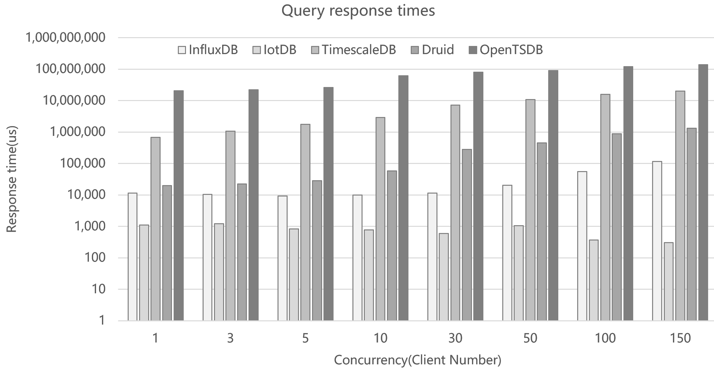
TS-Benchmark: a benchmark for time series databases
Query Test – response time
IotDB achieves better response time than other databases.
InfluxDB is second to IotDB, followed by Druid.
TimescaleDB and OpenTSDB are the most bad performing ones in terms of response time.
And OpenTSDB is the slowest database to handle the query load.
 | InfluxDB | IotDB | TimescaleDB | Druid | OpenTSDB
1 | 11,542 | 1,107 | 677126 | 19,806 | 20,440,966
3 | 10,345 | 1,205 | 1065172 | 22,341 | 21,975,824
5 | 9,348 | 822 | 1749476 | 28,546 | 25,747,924
10 | 9,953 | 776 | 2922655 | 57,336 | 60,951,978
30 | 11,402 | 595 | 7139071 | 279,311 | 78,965,533
50 | 20,080 | 1,051 | 10819995 | 448,233 | 89,587,663
100 | 54,772 | 373 | 15747781 | 882,152 | 118,731,148
150 | 115,777 | 306 | 19,877,354 | 1,332,498 | 139,723,308

Slide 16
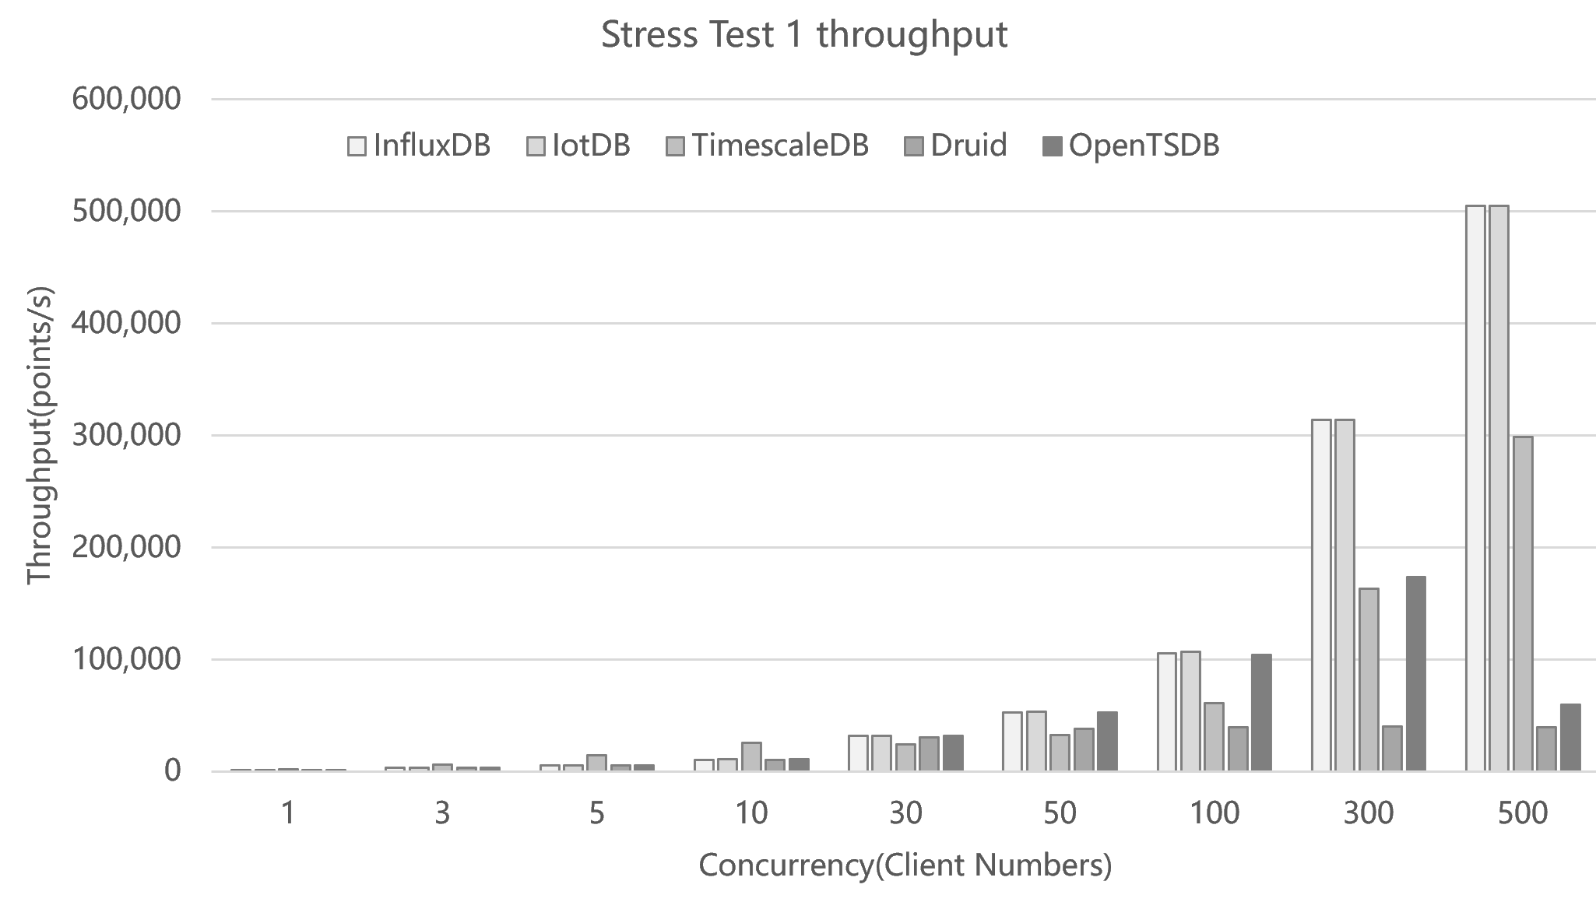
TS-Benchmark: a benchmark for time series databases
Stress Test 1 append (query)– throughput
We test how target databases handle appending when there is a background query stream.
The background steady query stream includes 50 clients, each client sends 2 queries per second, so there are 100 queries posed on target database per second.
In the mean time We gradually increase the number of append clients to increase appending pressures. Each client thread is responsible for appending data of 50 devices.
With the number of clients increasing, IotDB and InfluxDB achieve comparable throughput, followed by TimescaleDB.
Although TimescaleDB perform better than IotDB and InfluxDB when the concurrency is low.
Druid, and OpenTSDB are much inferior on appending than IotDB and InfluxDB.
 | InfluxDB | IotDB | TimescaleDB | Druid | OpenTSDB
1 | 1,071 | 1,071 | 1878 | 1,069 | 1,071
3 | 3,214 | 3,214 | 6352 | 3,179 | 3,214
5 | 5,305 | 5,357 | 14354 | 5,282 | 5,353
10 | 10,567 | 10,709 | 25878 | 10,522 | 10,682
30 | 32,065 | 32,100 | 24045 | 30,572 | 32,028
50 | 52,998 | 53,494 | 32825 | 37,735 | 52,588
100 | 105,620 | 106,973 | 60893 | 39,255 | 104,054
300 | 313,603 | 313,603 | 163,254 | 39,894 | 173,728
500 | 504,728 | 504,728 | 298,832 | 39,452 | 59,285

Slide 17
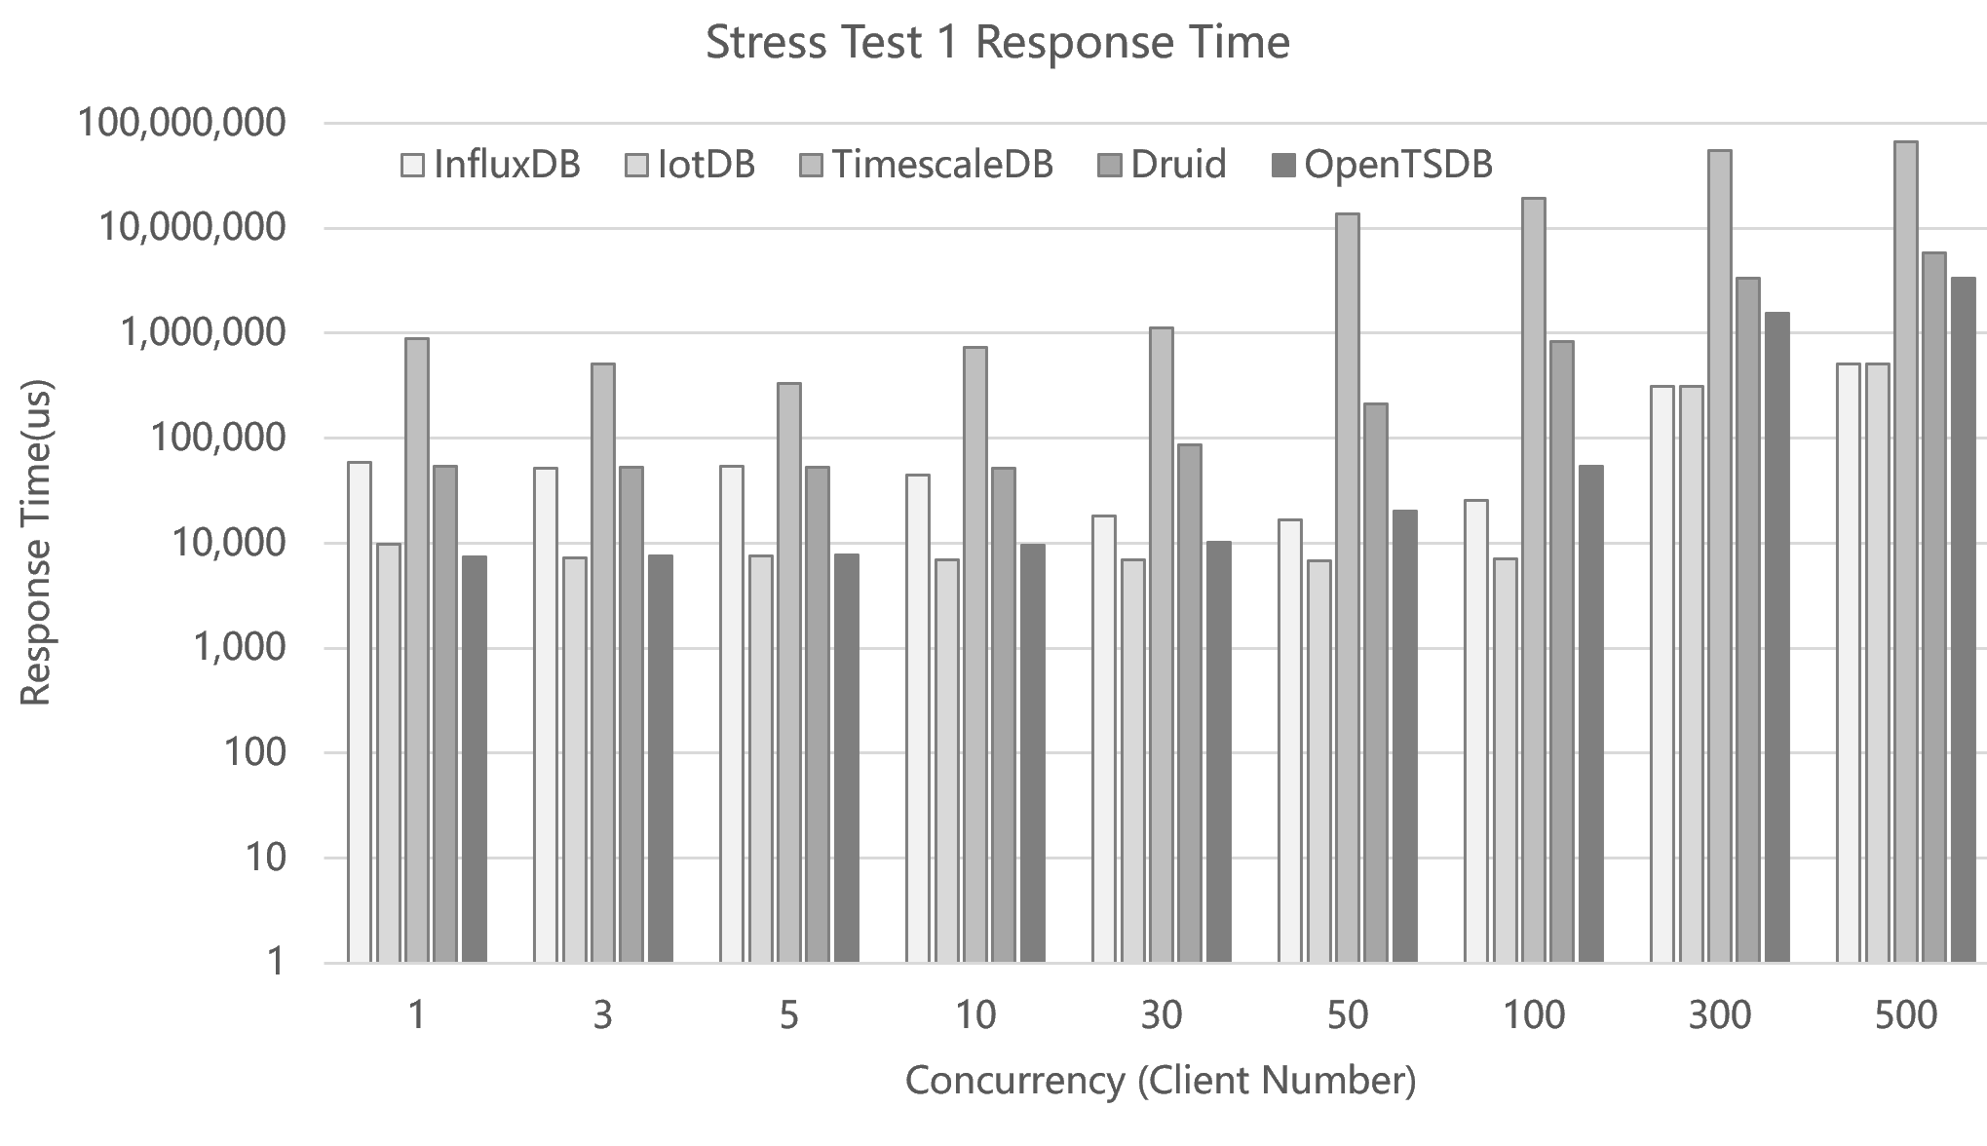
TS-Benchmark: a benchmark for time series databases
Stress Test 1 append (query)– response times
When concurrency is low, OpenTSDB(client number <=300) and IotDB achieve better response times than InfluxDB.
However when concurrency is high(client number >300), InfluxDB achieves better response time than OpenTSDB, and equal response time to IotDB.
Although when the concurrency is low, Druid is better than TimescaleDB.
Both Druid and TimescaleDB get the worst response times.
 | InfluxDB | IotDB | TimescaleDB | Druid | OpenTSDB
1 | 59,348 | 9,789 | 888251 | 53,944 | 7,380
3 | 51,535 | 7,307 | 509346 | 53,154 | 7,506
5 | 53,999 | 7,496 | 329546 | 52,448 | 7,744
10 | 45,015 | 6,904 | 733725 | 52,078 | 9,502
30 | 18,298 | 7,015 | 1130014 | 86,610 | 10,153
50 | 16,527 | 6,784 | 13581278 | 211,984 | 20,034
100 | 25,472 | 7,052 | 19452755 | 831,797 | 54,402
300 | 313,603 | 313,603 | 54,873,464 | 3,317,888 | 1,564,813
500 | 504,728 | 504,728 | 67,354,656 | 5,871,429 | 3,372,715

Slide 18
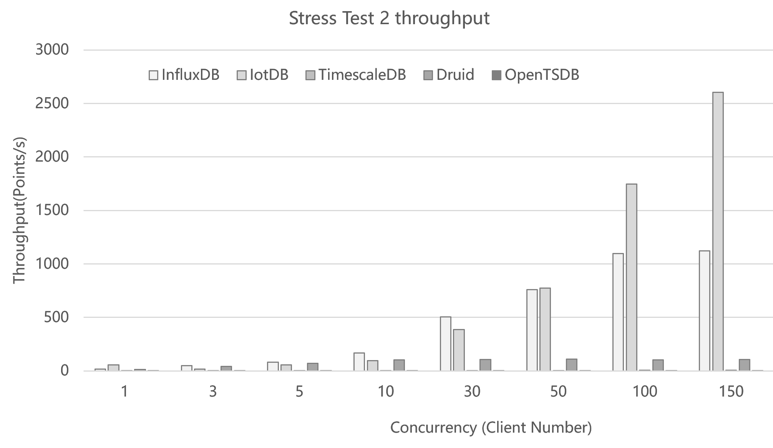
TS-Benchmark: a benchmark for time series databases
Stress Test 2 query(append)– throughput
We test how target databases handle queries when there is a background appending stream.
The background steady appending stream includes 10 clients, each client is responsible for 10 devices, with 100 devices in total. Each client send a snapshot of sensor data per 7 seconds.
In the mean time We gradually increase the number of clients to increase querying pressures. Each client thread send 20 query requests per second with a think time of 50ms.
With increasing of the client number, InfluxDB and IotDB achieve much higher throughput than other database, IotDB achieves the highest throughput.
TimescaleDB, Druid achieve less throughput.
And OpenTSDB performs the worst.
 | InfluxDB | IotDB | TimescaleDB | Druid | OpenTSDB
1 | 16 | 57 | 1 | 14 | 0.0263
3 | 49 | 19 | 2 | 43 | 0.0260
5 | 83 | 57 | 2 | 70 | 0.0223
10 | 167 | 96 | 3 | 105 | 0.0203
30 | 504 | 387 | 3 | 107 | 0.0094
50 | 760 | 775 | 3 | 110 | 0.0064
100 | 1,097 | 1,747 | 5 | 105 | 0.0045
150 | 1123 | 2603 | 5 | 108 | 0.0043

Slide 19
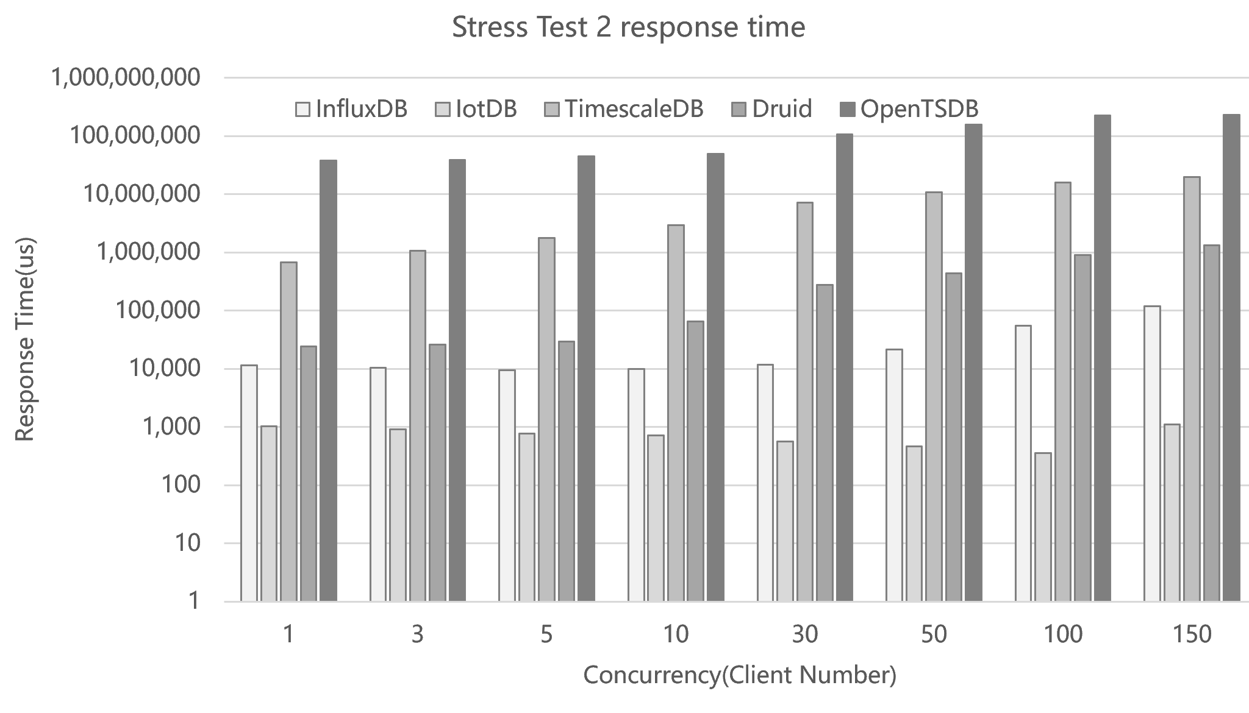
TS-Benchmark: a benchmark for time series databases
Stress Test 2 query(append)– response times
IotDB achieves better response time than other databases.
InfluxDB is second to IotDB, followed by Druid.
TimescaleDB and OpenTSDB are the most bad performing ones in terms of response time.
And OpenTSDB is the slowest database to handle the query load.
 | InfluxDB | IotDB | TimescaleDB | Druid | OpenTSDB
1 | 11,454 | 1,018 | 677126 | 24,178 | 38,019,957
3 | 10,375 | 924 | 1065172 | 25,924 | 38,434,704
5 | 9,441 | 765 | 1749476 | 29,395 | 44,796,683
10 | 9,854 | 715 | 2922655 | 64,618 | 49,191,116
30 | 11,790 | 560 | 7139071 | 275,062 | 106,852,689
50 | 21,577 | 464 | 10819995 | 437,607 | 156,009,483
100 | 55,122 | 355 | 15747781 | 908,555 | 222,922,643
150 | 119,461 | 1119 | 19871354 | 1,312,020 | 231,635,392

Slide 20
TS-Benchmark: a benchmark for time series databases
Preliminary conclusions
Specifically designed storage engine for time series benefit data injection and appending greatly
The result of stress test 1 append (query) is consistent with the result of append, when the background query workload is light, it is interesting to see how databases digest data when query workload is heavy.
The result of Stress Test 2 query (append) is consistent with the result of query, when the background append pressure is light, it is interesting to see how databases handles query when the append pressure is heavy.
Why OpenTSDB is so slow (query) need more analysis. (frequent compaction?)

Slide 21
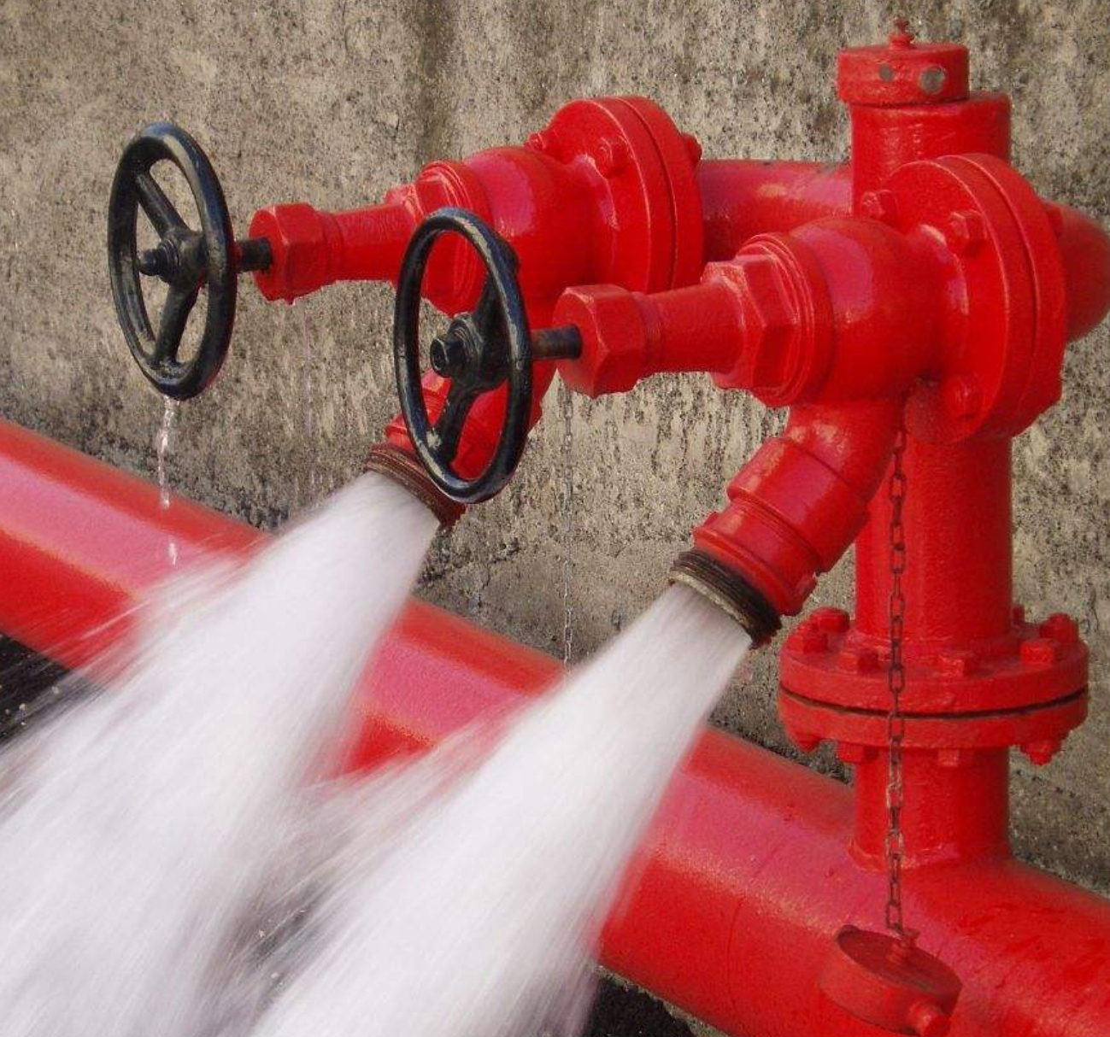
Thanks for your attention! chenyueguo@ruc.edu.cn Q&A

